Slide 1
Real-Time Sharing Among Real-Time Tasks
:
Chapter 3
RAJIB MALL
Professor
Department Of Computer Science & Engineering
IIT Kharagpur.

Slide 2
Organization
  Introduction to problems during resource sharing among real-time tasks
    Priority inversion problem
    Unbounded priority inversion
  Solutions
    Priority inheritance protocol
    Highest locker protocol
    Priority ceiling protocol

Slide 3
Critical Sections
The traditional operating system solution to share critical sections
  Is through the use of semaphores.
However, in real-time systems this solution does not work well, it gives rise to:
  Priority inversion
  Unbounded priority inversion

Slide 4
Priority Inversion
When resources need to be shared in the exclusive mode
  A task may be blocked by a lower priority task which is already holding the resource.
  A task holding a resource cannot be preempted,
    It would use the resource until it finishes all its required computation using it.
  The higher priority task cannot make progress while the lower priority task progresses.

Slide 5
Unbounded Priority Inversion
Consider the following situation
  A low priority task is holding a resource for which a high priority task is waiting
  However, an intermediate priority task which does not need resource preempts the low priority task.
  In this case, the priority inversions suffered by the high priority task can be unbounded
Can cause a task to miss its deadline

Slide 6
Priority Inheritance Protocol
Sha and Rajkumar
When a resource is busy
  The requests to lock the resource are queued in FIFO order
  The priority of the task using the critical section is raised to equal the highest priority task in the queue.
The main idea behind this scheme is that:
  Since a task holding a resource cannot be preempted, it should be allowed to complete as early as possible

Slide 7
Shortcomings of the Basic Priority Inheritance Scheme
Deadlock:
  T1: lock R1, Lock R2, Unlock R2, Unlock R1
  T2: lock R2, Lock R1, Unlock R1, Unlock R2

Slide 8
Highest Locker Protocol
During the design of a system
  a ceiling priority value is assigned to all resources
  The ceiling priority is equal to the highest priority of all tasks using that resource
When a task acquires a resource for use
  Its priority value is raised to the ceiling priority of that resource.

Slide 9
Highest Locker Protocol
Avoids unbounded priority inversion
Prevents deadlock
  T1: lock R1, Lock R2, Unlock R2, Unlock R1
  T2: lock R2, Lock R1, Unlock R1, Unlock R2
Prevents unbounded priority inversion

Slide 10
Shortcomings of HLP
Inheritance blocking
  When the priority value of a low priority task holding a resource is raised to a high value
  Intermediate priority tasks not needing the resource may undergo priority inversion.

Slide 11
Priority Ceiling Protocol
Each resource is assigned a ceiling priority
  Like the HLP
An Operating System variable is maintained as the highest ceiling of all locked semaphores.
  We will call it Current System Ceiling (CSC)
Unless a task holds a semaphore that set the current system ceiling
  It can lock a resource only if its priority is greater than CSC

Slide 12
Priority Ceiling Protocol (PCP)
If a task is prevented from locking a resource
  The task holding the resource inherits the priority of the blocked task.
PCP prevents deadlocks.
Prevents unbounded priority inversion
Limits inheritance-related inversion.

Slide 13
Types of Priority Inversion in PCP
Direct inversion
Inheritance-related inversion
Avoidance-related inversion

Slide 14
Direct Inversion
A higher priority task waits for resource as a lower priority task is holding the resource.

Slide 15
Inheritance-related Inversion
When a low priority task is holding a resource and a high priority task is waiting for it
  The priority of the low priority task is raised.
  An intermediate priority task that does not need the resource being held, undergoes inheritance-related inversion.

Slide 16
Avoidance-related Inversion
When a low priority task is holding a resource
  The CSC is made equal to the ceiling of the resource being held
  A high priority task which needs a resource currently not in use undergoes avoidance-related inversion

Slide 17
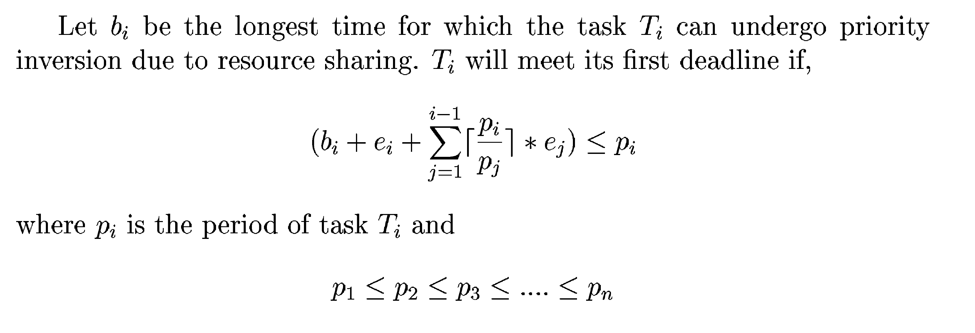
Liu and Lehotczy Condition Under Resource Sharing

Slide 18
Resource Sharing for Dynamic Priority Systems
The priority ceiling values would change dynamically with time.
  An obvious solution would be to update the priority ceiling of each resource and the current system ceiling each time the priority of a task changes
However, this would incur unacceptably high processing overhead.

Slide 19
Summary
If semaphores are deployed scheduling shared resources for real-time tasks,
  Unbounded priority inversions might occur
  leading to real-time tasks to miss their deadlines
The simple priority inheritance mechanism
  prevents unbounded priority inversions.
  However, it becomes the programmer's responsibility to overcome the deadlock chain blocking.

Slide 20
Summary
Priority Ceiling Protocol (PCP) incorporates additional rules in the basic PIP
  overcomes the deadlock, unbounded priority inversion, and chain blocking problems.

